Slide 1
PHOTO DEDUPLICATOR
GROUP A

Slide 2
Why don’t programmers like nature? It has too many bugs.
An SQL query goes into a bar, walks up to two tables and asks: “Can I join you?
My programmer friend said I have a high IQ. He said it's 404.

Slide 3
Agenda
01. Project methodology
02. Implementation team
We will discuss the pros and cons of waterfall and agile methodologies and give our reasons for our chosen methodology.
We will discuss three job roles essential to the implementation team to cover all aspects of the delivery.
03. Project Plan
04. Prototype
05. Testing
We will show job roles and responsibilities for each job role throughout each of the development stages. We will also discuss specific features and business objectives.
We will demonstrate the prototype to illustrate its functionality and show you the code for it.
We will discuss our test table and what tests have passed and what needed a little more work.

Slide 4
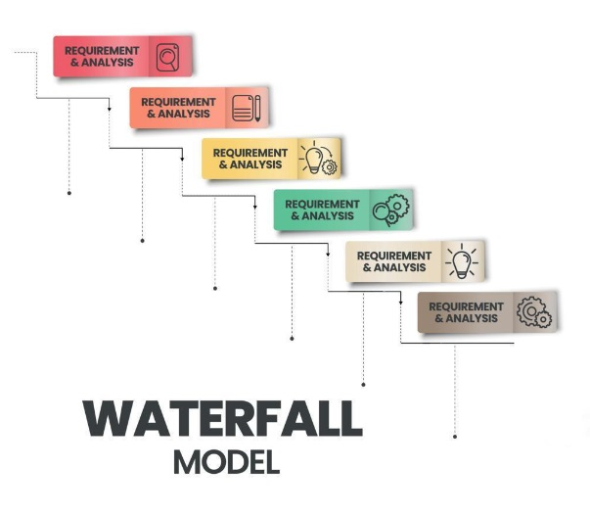
METHODOLOGIES
WATERFALL
PROS:
Clear structure with defined phases which makes it easy to understand and manage each stage
More accurate projection of time & cost
Easier to manage and efficient as it has well-defined requirements that will not change.
Each step is well documented ensuring that all team members are on the same page and requirements are clear.
CONS:
Less adaptable and can be costly if changes required
Testing late in the cycle could be costly if issues are found
Feedback comes in late leading to significant rework if requirements were not clear
Due to the sequential approach if any phase fails, it can jeopardize the project
Risks have to be identified and addressed during initial stages
Best suited for projects that have well defined requirements from start to finish. It is easy to manage however can lack flexibility. It gives predictability and structured documentation.

Slide 5
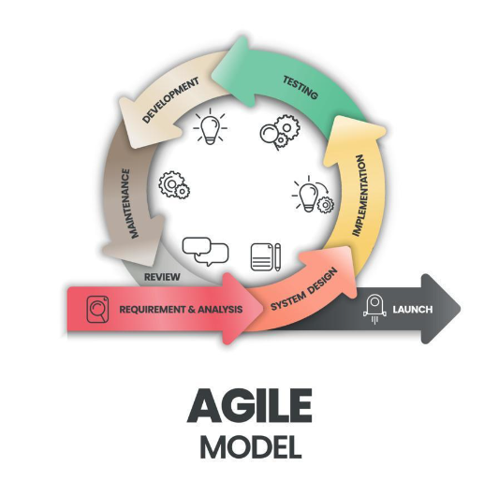
METHODOLOGIES
AGILE
PROS:
Flexible and adaptable allowing for changes even late in development
Regular feedback allows users to ensure product meets their needs
Offers better communication among team allowing for better problem solving
Early testing reduces risk of major issues down the line
After every cycle, teams engage and reflect on ways to enhance their efficiency
CONS:
- Could lead to scope creep - changes and additions could extend both timeline of project and costs
- Requires constant involvement from team members and customers which can be time- consuming
Harder to predict timeline and costs to project that could lead to poor decision making
Great for projects that may need to evolve and feedback is required throughout the process. It is flexible and can be continuously improved with fast delivery. It can suffer from scope creep.

Slide 6
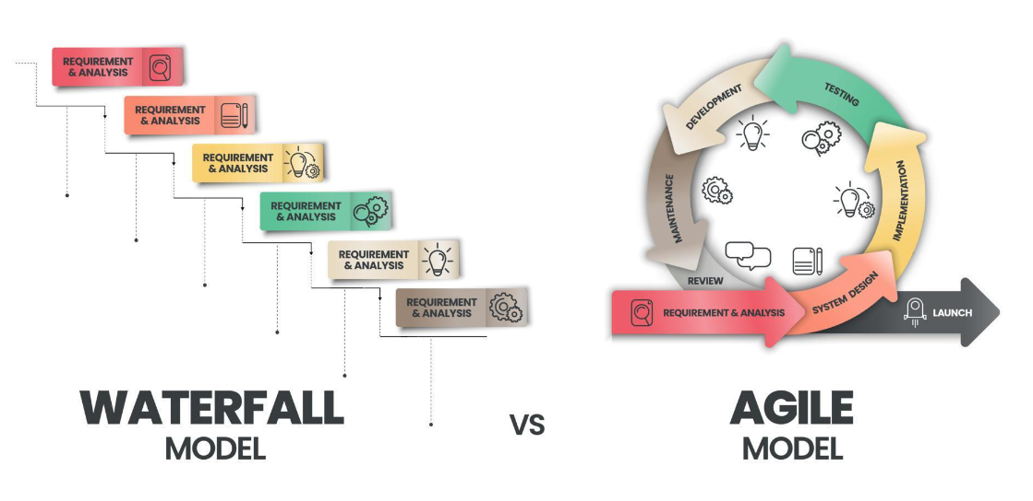
METHODOLOGIES
Our chosen methodology: AGILE
We have chosen the Agile Methodology for our Photo DeDuplicator project due to its flexibility and continuous feedback that can be obtained throughout all stages including the earlier testing stages. It has also allowed us to make any required changes throughout the development and will allow for any evolving features in the future.

Slide 7
IMPLEMENTATION TEAM
Lead Developer
Product Owner
Quality Assurance Engineer
Responsible for coding, integration and testing.
Ensures best coding practices and coding standards.
Manages development team, assigns tasks and ensures project meets requirements
Acts as voice of the customer
Defines product requirements, and user stories.
Meets with other team members to ensure quality and functionality meets customers expectations
Responsible for quality and reliability
Designs and runs test plans, test cases and test scripts.
Ensures product meets the specified quality standards.

Slide 8
LEAD DEVELOPER
JOB DESCRIPTION
Ensure adherence to best coding practices and standards
Design and develop high quality code
Collaborate with other team members/departments to define project requirements and deliver updates throughout the process
Fix bugs and issues when and if required
Create and update documentation to ensure it is up to date
Proficiency in the relevant programming languages (e.g., HTML, Python, CSS)
Have a strong understanding of software development methodologies (e.g., Agile, Waterfall, Scrum)
Strong communication and interpersonal abilities
Problem-solving and critical-thinking skills
Expertise in system architecture and design patterns.

Slide 9
PROJECT MANAGER
JOB DESCRIPTION
Have a strong understanding of software development methodologies and processes
Be proficient in using product management systems (JIRA, Trello)
Strong leadership and decision making skills
Excellent communicator and analytical thinker
Communicate with team members, ensuring sufficient progress is being made and making informed adjustments when necessary tecture and design patterns.
Define the product vision and strategy and ensure it aligns with the business' goals and objectives
Create and manage product requirements and user stories
Gather requirements from stakeholders/customers and ensure all departments understand these requirements
Take the lead over review meetings and sprint planning meetings
Collect user feedback and use it to improve the product

Slide 10
QA ENGINEER
JOB DESCRIPTION
Develop test plans and strategies and define the test objectives and criteria
Write detailed test cases that cover all functional and non-functional requirements
Execute manual tests to identify bugs and issues and then document and report the findings
Conduct performance, load and stress tests and report findings
Perform regression testing to ensure code changes do not create new defects
Set up and maintain test environments
Have a strong understanding of software development methodologies and processes
Be proficient in using product management systems (JIRA, Trello)
Detail-oriented with very strong analytical skills
Excellent communication and collaboration abilities
Problem- solving and critical- thinking skills
design patter.

Slide 11
DEVELOPMENT STAGES
DEVELOPMENT STAGES | DEVELOPMENT STAGES
ROLE | PLANNING | DESIGN AND DEVELOPMENT | TESTING AND IMPLEMENTATION | DEPLOYMENT | MONITORING AND UPDATE RELEASES
PROJECT MANAGER | Provide detailed instructions for the planning, organizing, controlling, managing and reporting the project resources | Plan sprints, versions, and releases according to the Photo DeDuplicator project roadmap. Manage development iterations, organise the development events | Work with the development team, plan sprint increments | Coach the whole team, report on time/efforts and delivered features, remove obstructions for the team. | Ensure efficient communication between the Product Owner and the other members of the team. Tasks would end when project goals and objectives are successfully completed, product is delivered
BUSINESS ANALYST | Analyse, communicate and document the requirements, business needs and goals for the Photo DeDuplicator with stakeholders, developers and other participants | Analyse and validate the detailed requirements of the project, creating and maintaining design artefacts (such as prototypes) and specifications. Oversee the changes and issued that arise during design. | Ensure that the final product meets the business requirements. Help the technical team to resolve requirement related roadblocks | Serve as the first point of contact for users when they face issues and provide feedback. | Coordinate the development team, organise future updates in the software or implements the required fixes.
SOLUTIONS ARCHITECT | Try to understand constraints of the project. Considers technical and business factors which align with the project goal | Ensure all requirements are met during development and examine the limitations of the project to optimize alternatives, and reduce risks | Make crucial technical decisions which impact project’s ultimate results (such as technology stack and integration with third-party systems) | Act as the link between the technical team and the project manager | Ensure continuous maintenance of the product developed so it works properly.

Slide 12
DEVELOPMENT STAGES
DEVELOPMENT STAGES | DEVELOPMENT STAGES
ROLE | PLANNING | DESIGN AND DEVELOPMENT | TESTING AND IMPLEMENTATION | DEPLOYMENT | MONITORING AND UPDATE RELEASES
LEAD DEVELOPER | Work closely with the Project Manager, Business Analyst, and other stakeholders to understand requirements and translate them into technical specifications | Provide technical direction and execution of the Photo DeDuplicator project. Oversee the entire development process, from design, coding, testing, and deployment | Manage the development team, assigns tasks, conduct code reviews, and ensure adherence to coding standards and best practices. Also guide the development team, create a collaborative environment, and promote continuous learning and improvement. | Oversee deployment process and ensure a smooth release | Stay up-to-date with the latest technologies, tools, and industry trends, and recommend appropriate updates and improvements for the project
QA ENGINEER | Collaborate with the Business Analyst and stakeholders to understand the requirements | Review the design documents and provide feedback from a testing perspective. Participate in code reviews and provide feedback on code quality, testability, and maintainability | Develop and execute comprehensive test plans, test cases, and test scripts to validate the functionality, usability, and performance of the application. Identify and report defects, prioritize them based on severity and impact, and track them through resolution Develop and maintain test automation frameworks and scripts to streamline the testing process and improve test coverage. | Collaborate with cross-functional teams to ensure a smooth delivery and deployment process. Ensure compliance with industry standards, best practices, and quality assurance methodologies. Perform final testing and validation before release | Continuously monitor and test the application for any issues or defects. Update and maintain test cases and automation scripts for future releases.

Slide 13
COMMITMENTS
FEATURES
BUSINESS OBJECTIVES
Application has cross-platform compatibility- can be used with various operating systems Windows and macOS
The application supports a wide range of formats such as .png , .jpeg and .gif. It recognises all formats and is able to spot duplicates within a folder
It has a friendly interface that is easy to understand no matter the skillset of the user.
It will end up saving storage space as duplicate files can be deleted, freeing up storage space.
The project must be cost effective without sacrificing quality or functionality
The application must comply with relevant regulations regarding safeguarding, user data and security
There should be security measures within the application to protect the users sensitive data and the user’s system
The application should be able to handle big workloads without any effects on the performance

Slide 14
Future Features
Advanced Image Algorithms
Batch Processing
Customizable Filters and Exclusions
Add techniques like Difference Hash (dHash) and Wavelet Hash (wHash) to improve the accuracy of finding duplicate images, especially for images that have been cropped or rotated.
Introduce batch processing, this would allow users to select multiple folders or drives, and the program would scan all of them at the same time to find duplicate images. Skills Required: Knowledge of Python directories like : os.walk, os.listdir. Data structures like lists or queues to store and manage the file paths. UI design to integrate choice in menu.
This would allow users to define specific rules to include or exclude certain files from the deduplication process. For example user could exclude file types or files based on their size or date modified.
Skills Required: Knowledge of Python. Regular expressions for pattern matching (e.g., re module in Python). File system operations to check file size, creation date, or modification date. UI design to integrate these filters.
Skills Required :
Knowledge of image processing libraries like OpenCV /Pillow; Algorithm development in Python.
To implement these future features our Lead Developer will need to enhance their skills in Python programming, working with file systems, and creating user interfaces. Our QA Engineer's abilities to design test cases, perform different testing methods, and handle errors will be very important to make sure the Photo DeDuplicator application works reliably.

Slide 15
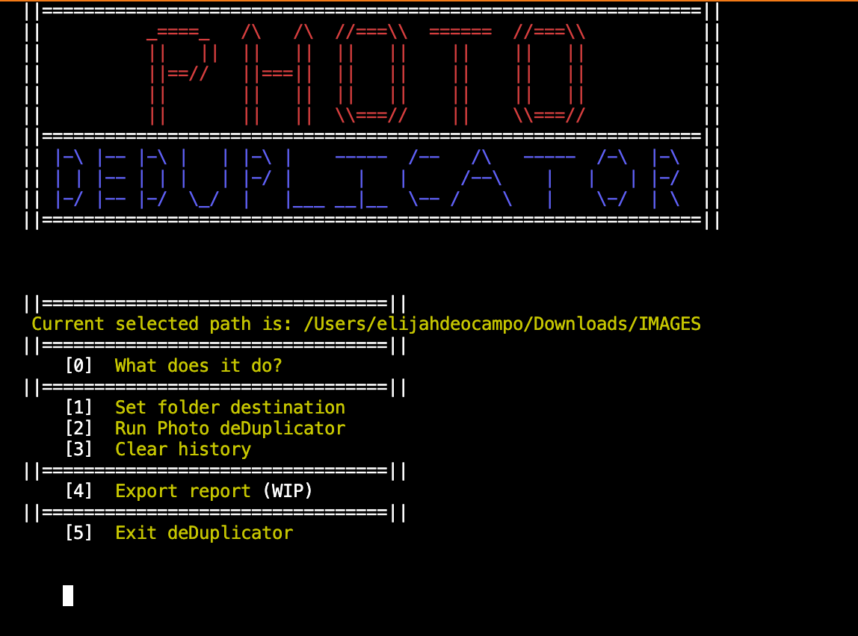
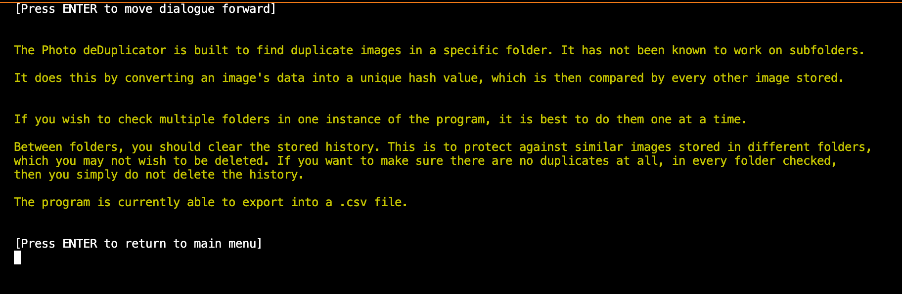
PROTOTYPE
This is the starting screen and main menu of the program. There are 5 options that the user can choose from that will all be explored in this section of our presentation.
If the user inputs option '0', it will lead them to the page above which offers information on the Photo De-duplicator application's functionalities and also how to use it correctly. After viewing this, they can press 'Enter' to return to the main menu.

Slide 16
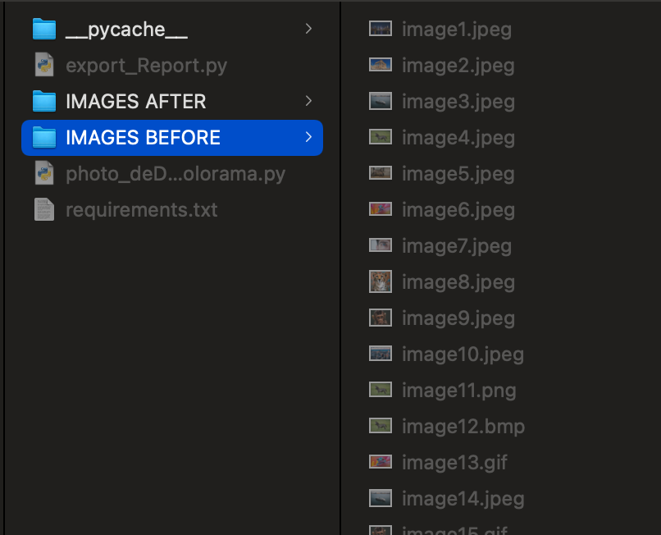
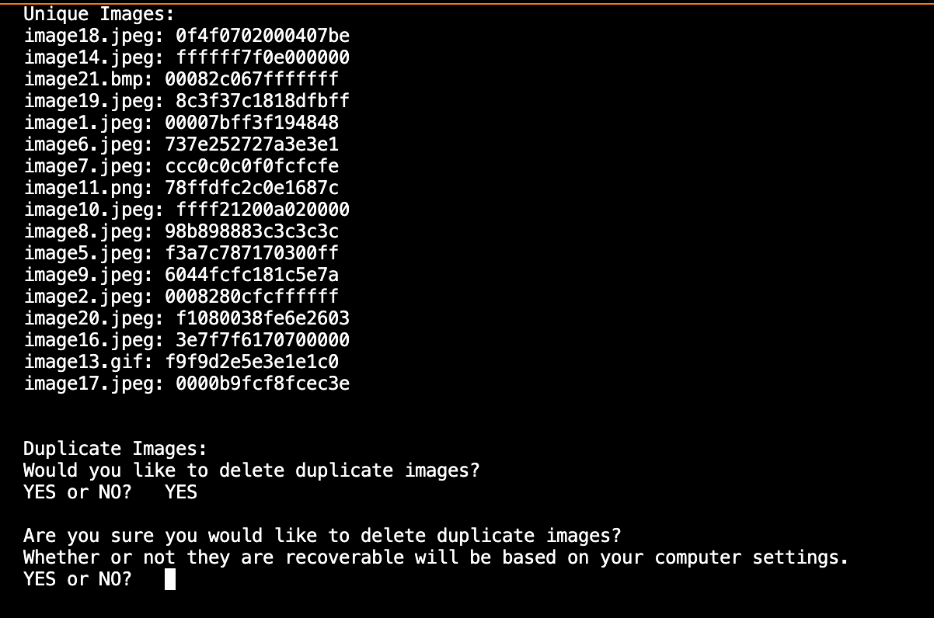
Option '1' in the main menu sets the folder destination that the program will run inside of. Once the user chooses this option, the user system's file manager will pop up to choose the folder that the user wants to select. In this case, it opens up the 'Finder' as this demonstration is being made on the macOS system.
After the folder is selected the destination of the folder will appear in the main menu above the options.
Option '2' in the main menu runs the De-duplicator code and created a list of all the images in the folder. It then creates a list of the duplicate images, regardless of their file types. It then asks the user if they want to delete any duplicate images. IF they choose 'YES', a warning is given to verify if the user wants the duplicates deleted.

Slide 17
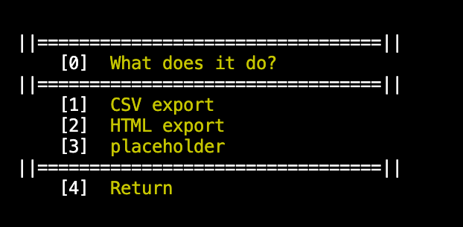
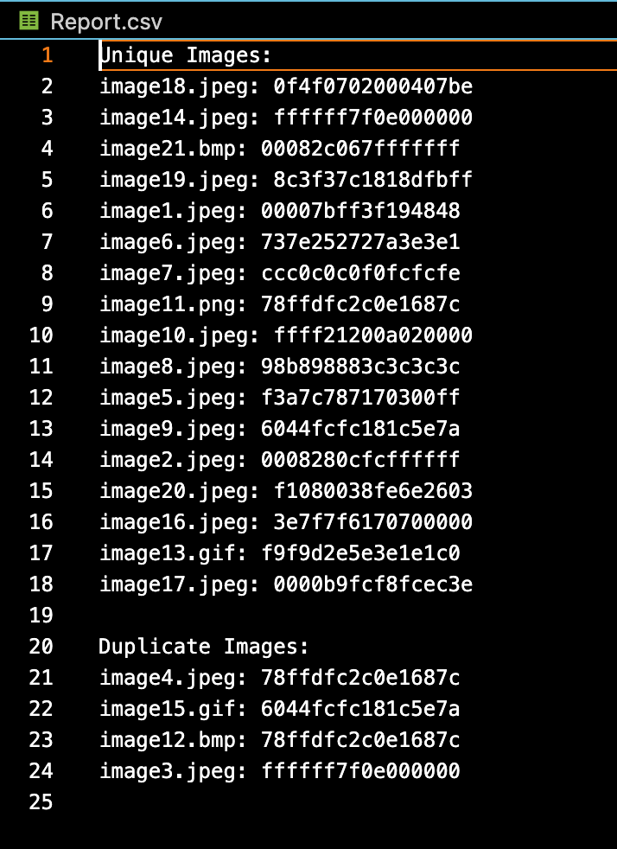
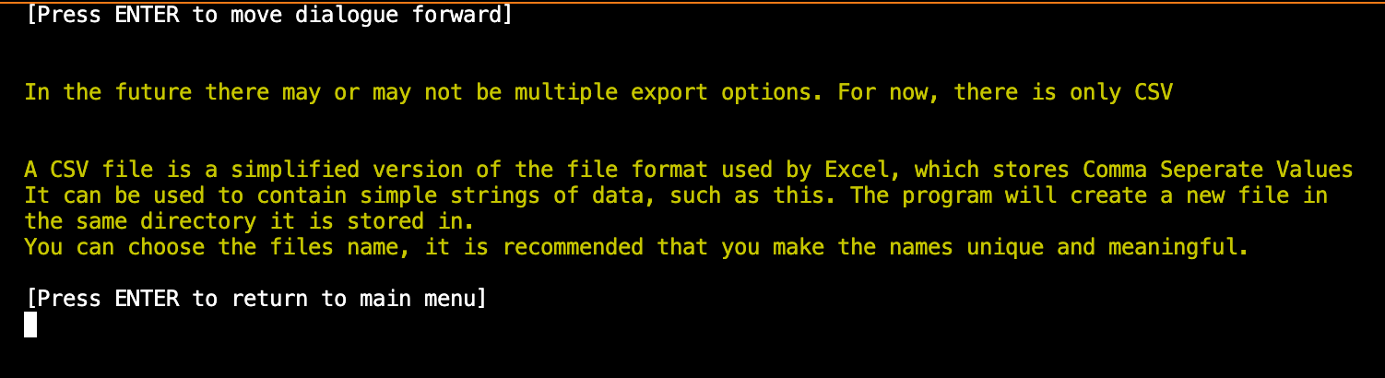
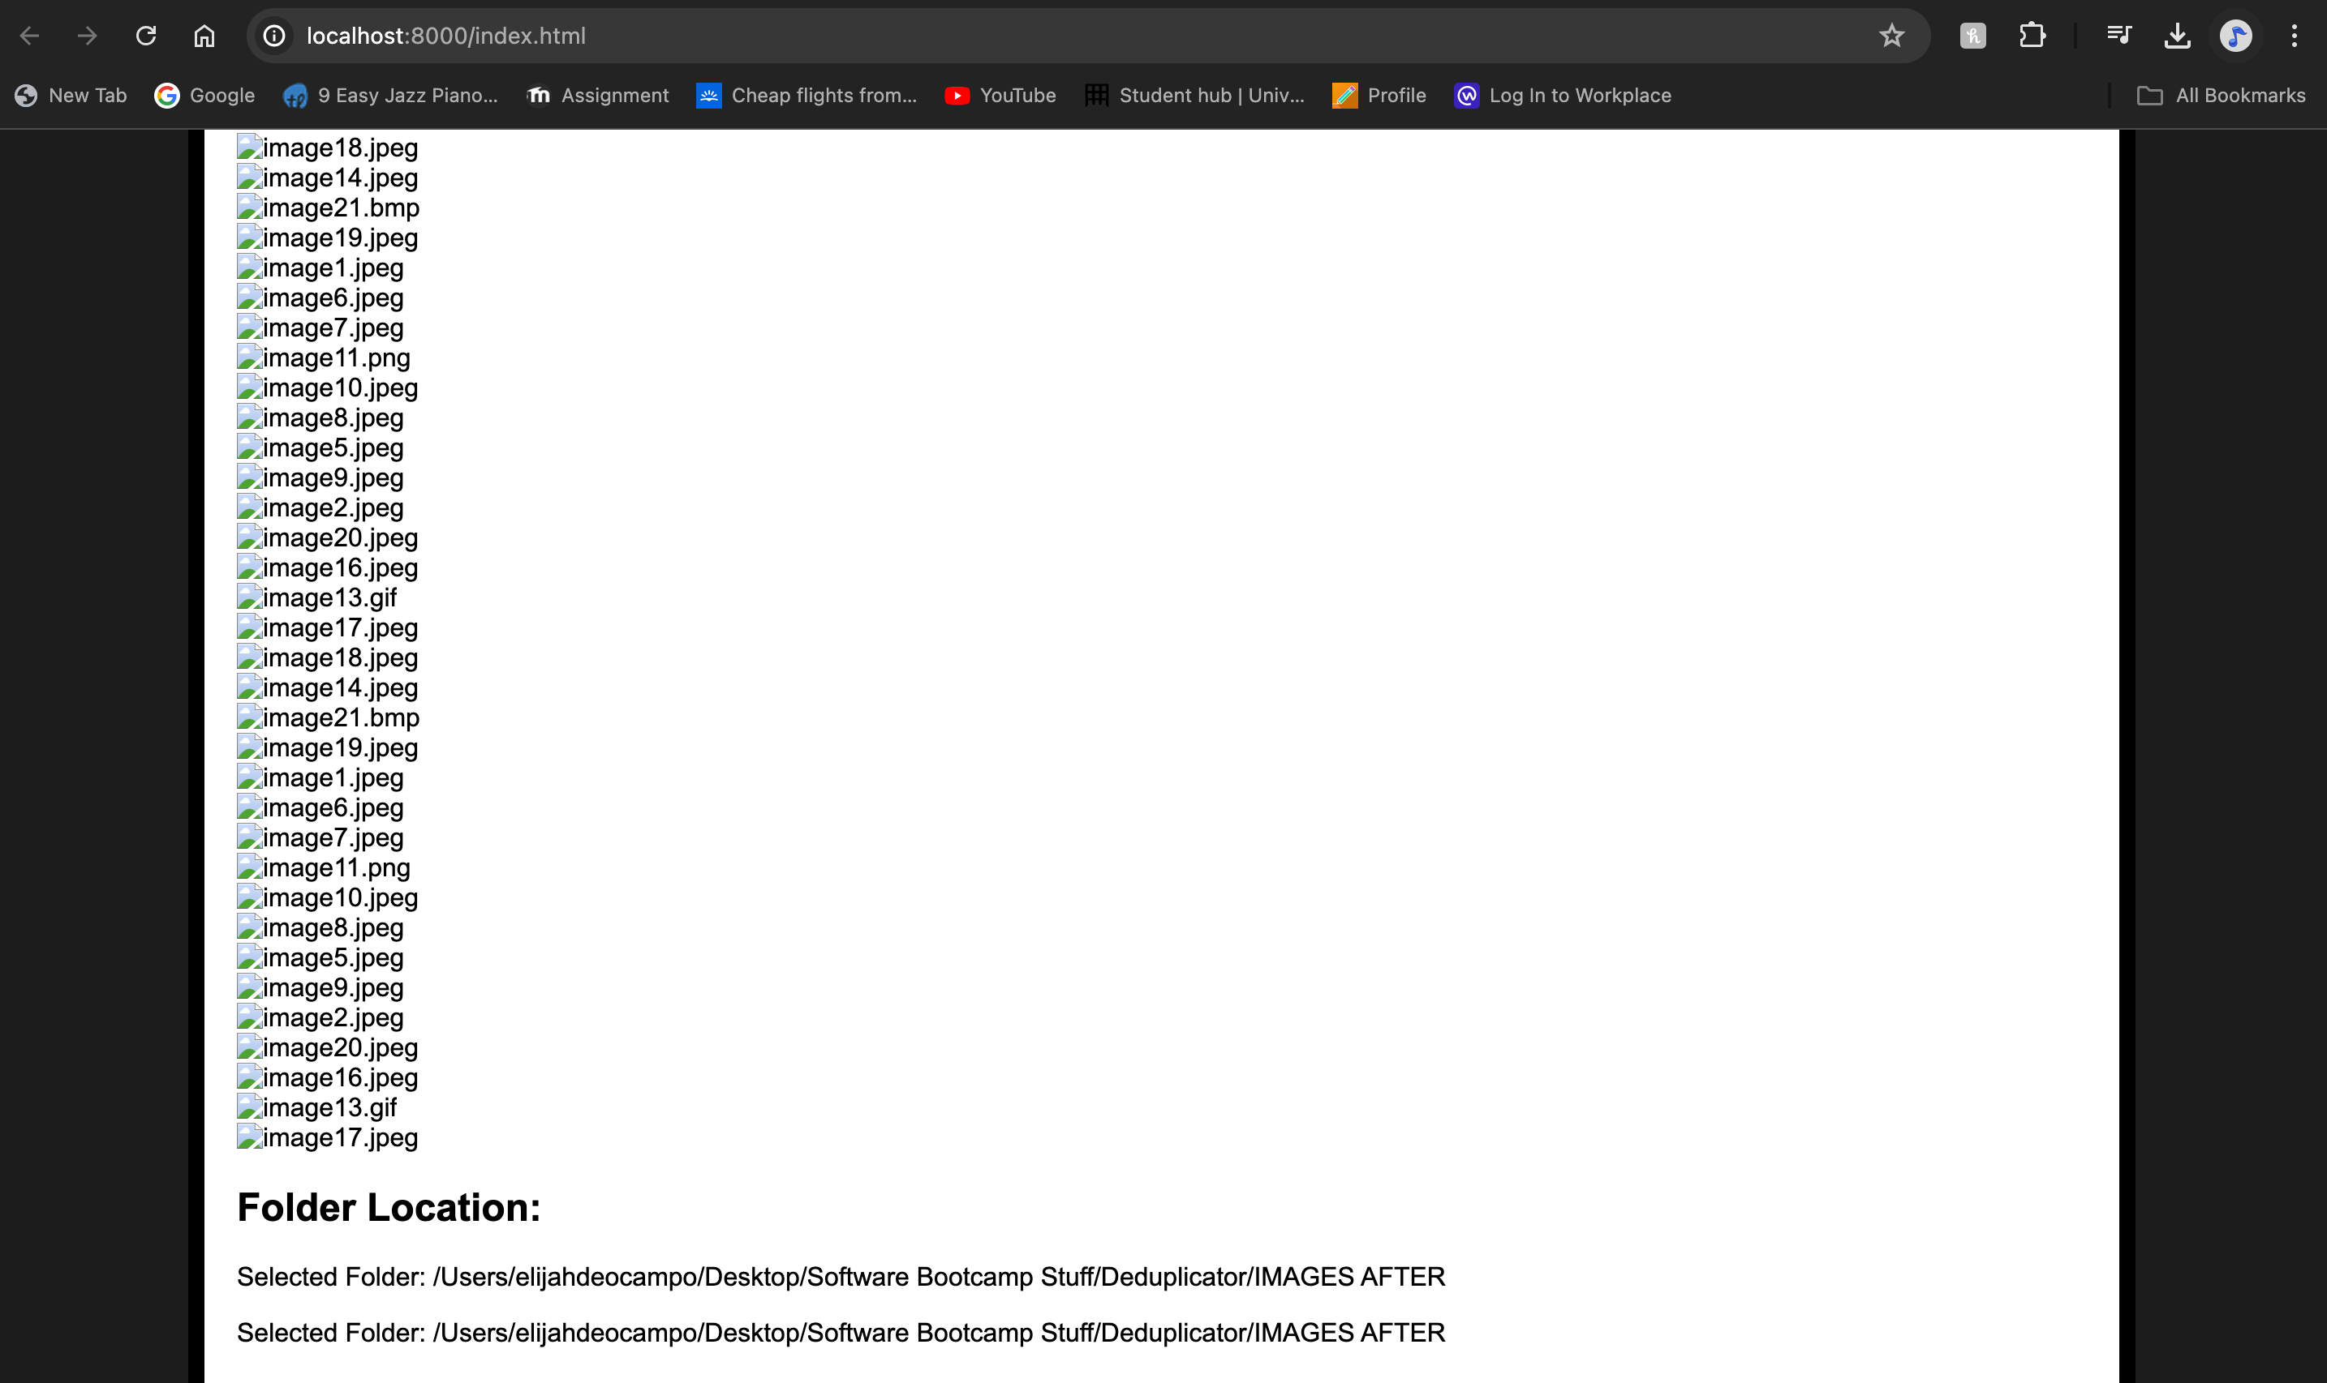
Option '3' will clear the history of the program. As specified in Option '0' (what does it do), this option should be inputted when the user wants to run the program on another file.
Option '4' is the where the export function is. When inputted, the user will be taken to another menu with different options. Option '0' will take the user to a section that explains what the different options do. This being a prototype, it currently has two working options which creates a report either in a CSV file within the program or on a HTML page. Option '4' will return to the main menu.
Option '0' (Info)
Option '2' (HTML)
Option '1' (CSV)

Slide 18
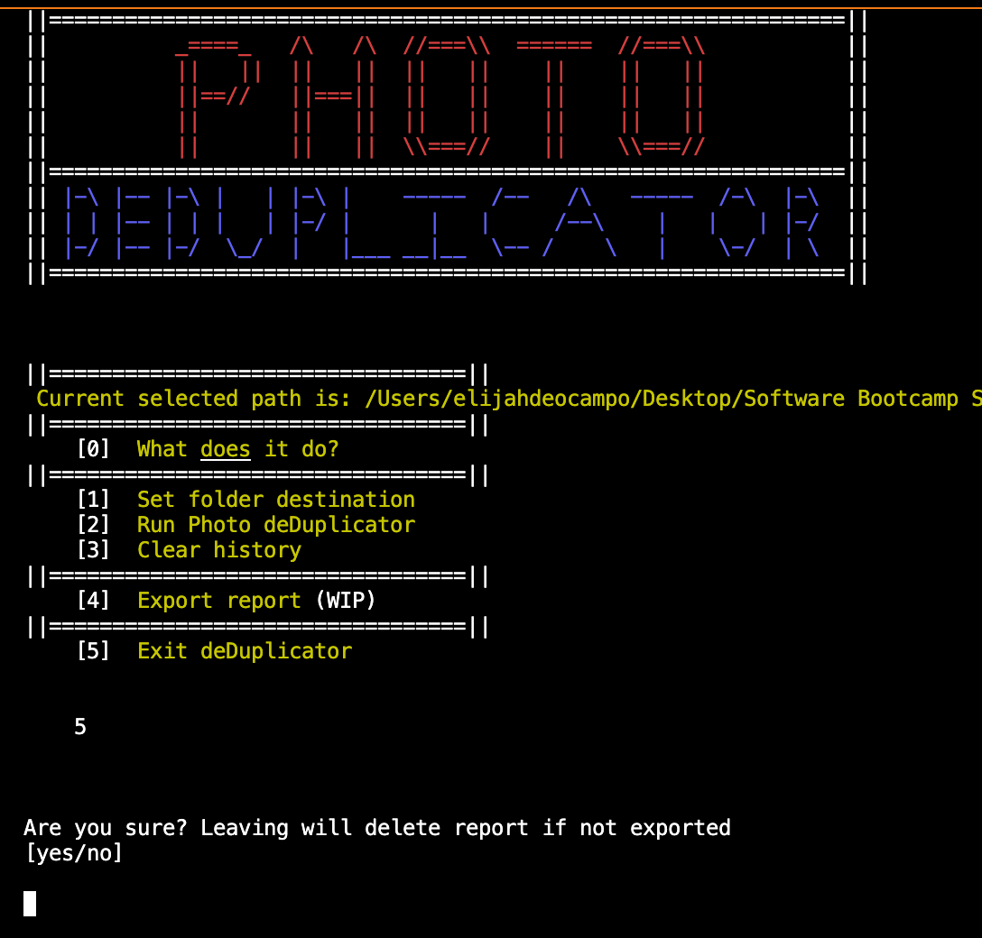
Finally, option '5' will exit the program. Once inputted, the user will be asked if they are sure they would like to exit as if the report has not been exported, it will be deleted.

Slide 19
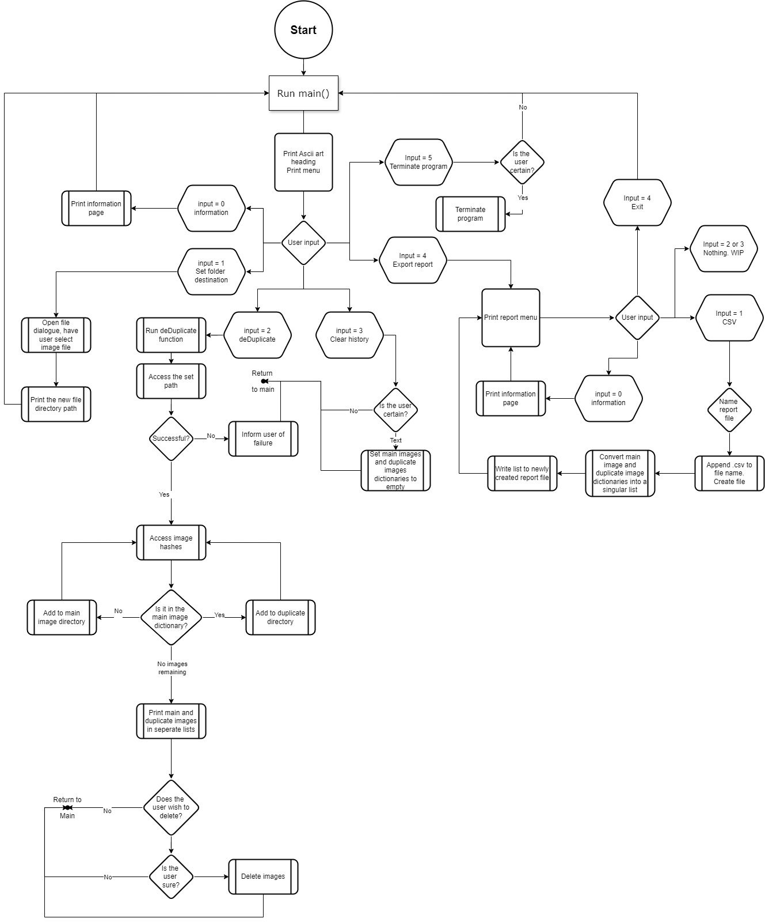
PYTHON CODE IMPLEMENTATION

Slide 20
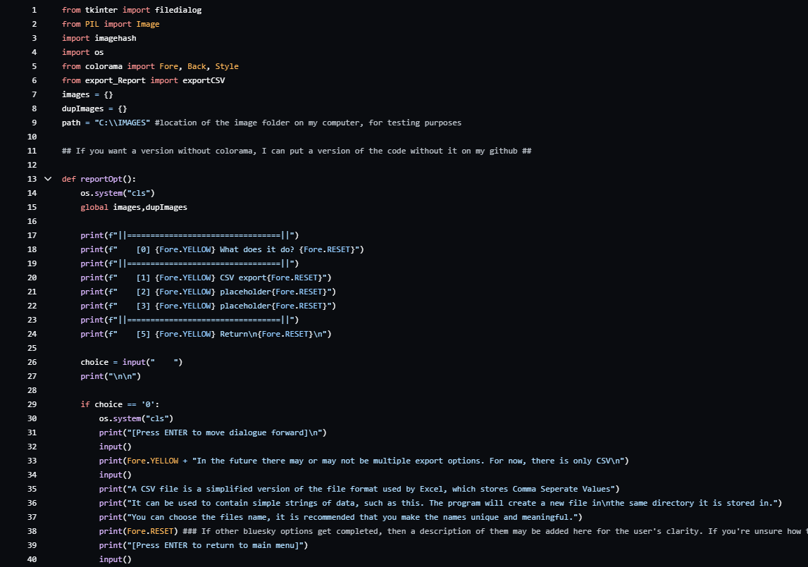
CODE

Slide 21
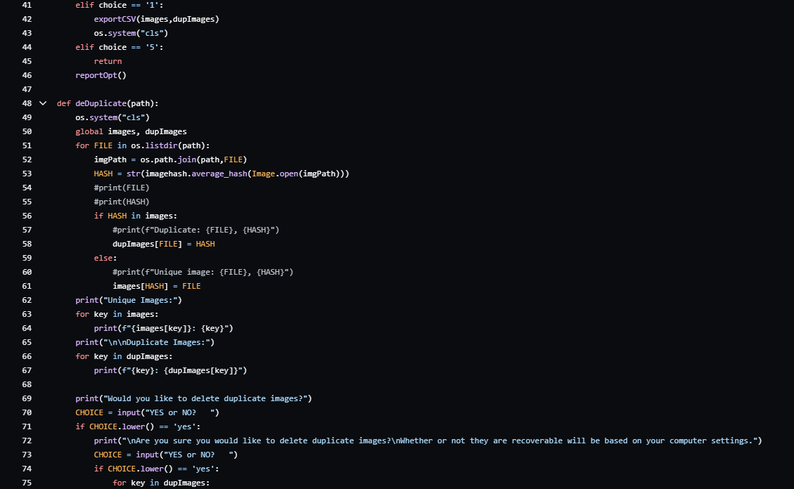
CODE

Slide 22
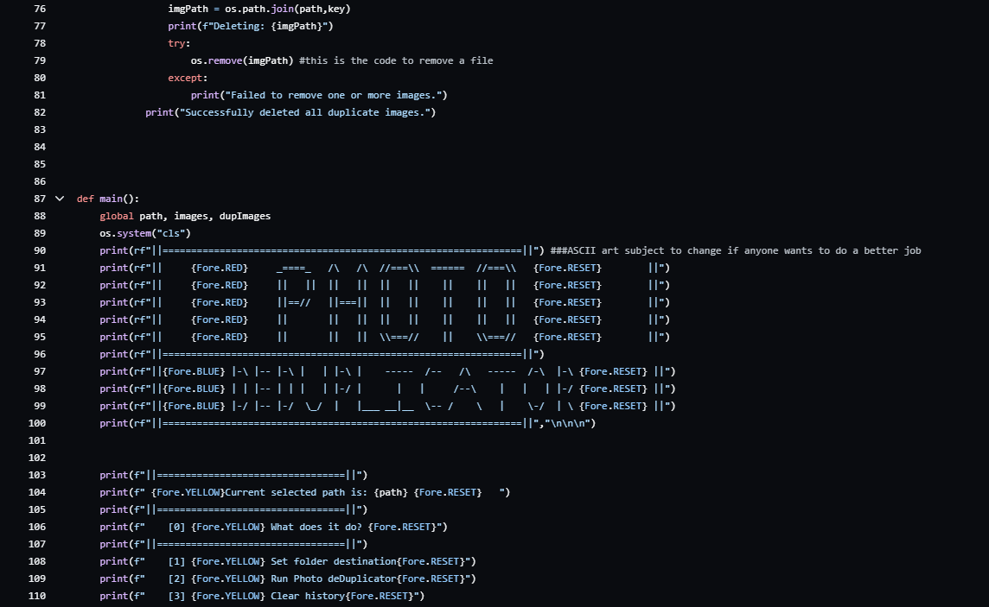
CODE

Slide 23
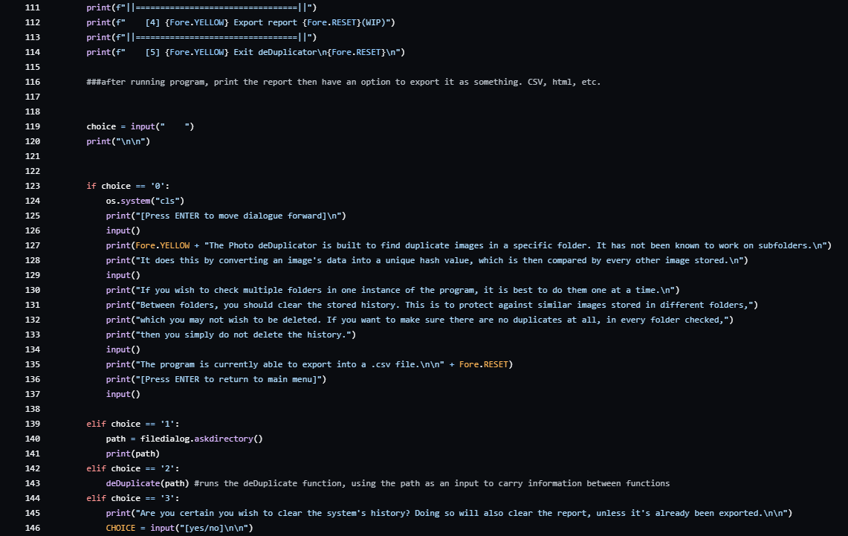
CODE

Slide 24
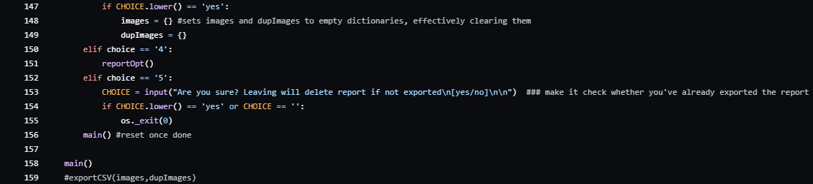
CODE

Slide 25
TESTING
Test Case ID | Test Case Description | Test Data | Expected Result | Pass/Fail | Correction Plan
TC – 01 | Test ‘path’ location | Add folder path | Display folder location and all items in location. | PASS
TC – 02 | Test De-Duplication functionality with images | Add folder path that holds unique and duplicated images | Display a list of all images and separate list of duplicates found. | PASS
TC – 03 | Test ‘path’ location if path is empty or does not exist | Add a non-existent path location | Display error message ‘Path not found’ | FAIL | Implementing an error message in the code whenever a clear file path isn't present.
TC – 04 | Test functionality with different image formats | Add folder path that holds various image formats | Display images even if in different formats without errors. | PASS
TC – 05 | Test user interface to ensure instructions are clear | Try running on different screen sizes and resolutions | Ensure it is all positioned well, readable and easy to follow | PASS
TC – 06 | Test operating system cross-compatibility | Try running on Windows and MAC operating systems | Ensure runs well on both operating systems | PASS
TC – 07 | Test De-Duplication functionality with images that are similar but differ in size. | Add folder path that holds similar looking photos but different formats and sizes | Display a list of duplicates found. | FAIL | Implement in future updates as mentioned in “Future Features”

Slide 26

Thank you
Completing our final project wouldn’t have been possible without the dedication, support, and hard work of this incredible group. Thank you all!
To our cohort - it has been an absolute pleasure working alongside each of you. You made these 13 weeks of intense effort truly enjoyable. Hope our paths cross again soon!
To John – our deepest gratitude goes to you! You’ve shared years of knowledge in such a short period and pushed us beyond what we thought we could achieve. We leave this bootcamp feeling confident and prepared for any challenge, thanks to your countless hours of guidance and support. You truly are an amazing tutor, and we are all very fortunate to have met you!

